Slide 1


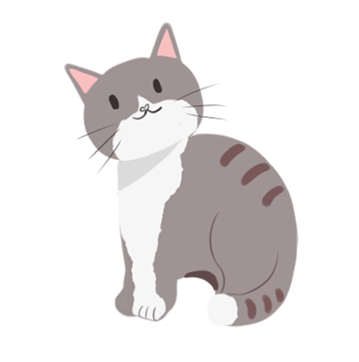

重阳节
The Double Ninth Festival

Slide 2
重阳节英文介绍
When clear and refreshing autumn arrives and chrysanthemums envelope the world, it's time for the Chinese Chongyang Festival, or Double Ninth Festival.
The Double Ninth Festival falls on the ninth day of the ninth month on the Chinese lunar calendar. In Chinese folklore, the number nine is the largest number - it's a homonym to the Chinese word jiu, which contains the auspicious meaning of "a long and healthy life".

Slide 3

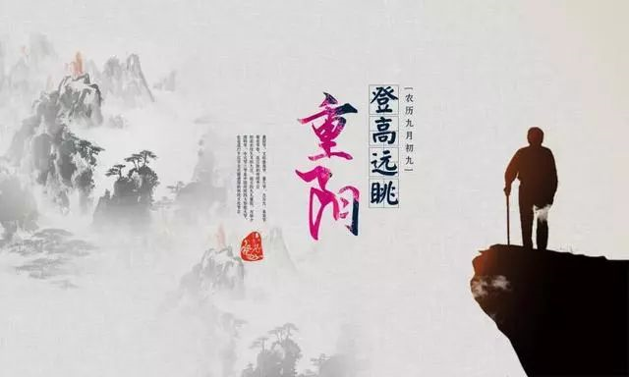
Climbing Mountains 登高

Slide 4
Climbing Mountains 登高
Apart from expelling bad luck and disasters, climbing mounting also indicates “climbing to a higher position”, and it is also an important reason why ancient people pay much attention about this custom. Another reason that climbing mountains are valued by people, especially by the elderly is that is has a meaning of “climb to a longevous life”. Also for this reason people believe that climbing mountains can make people live a more longevous life.

Slide 5
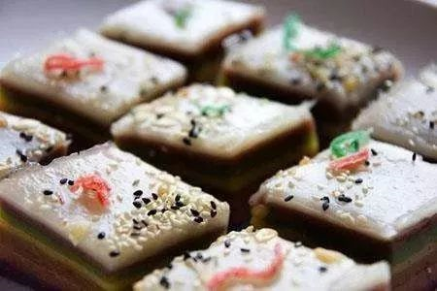
吃重阳糕 Eating Double Ninth Cake

Slide 6
吃重阳糕 Eating Double Ninth Cake
Though the name of "Gao" started from the Six Dynasties, the cakes had already existed in Han Dynasty, which was called "Er" in China at that time. It is made of rice flour, which is classified into two types: paddy rice flour and millet rice flour. In September, the millet is ripe. It is regarded as the food just in season, which is offered to ancestors as sacrifices.

Slide 7
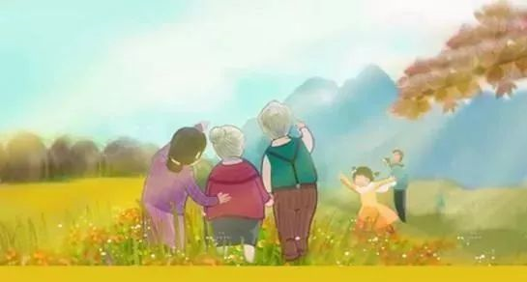
家人团聚 Family get-togethers

Slide 8
家人团聚 Family get-togethers
The Double Ninth Festival is also a time for family get-togethers. It is an occasion to remember one's ancestors, the sacrifices they made and the hardships they undewent. Often, family outings are organised during which people search to renew their appreciaiton of nature and to reaffirm thir love and concern for family members and close friends.

Slide 9
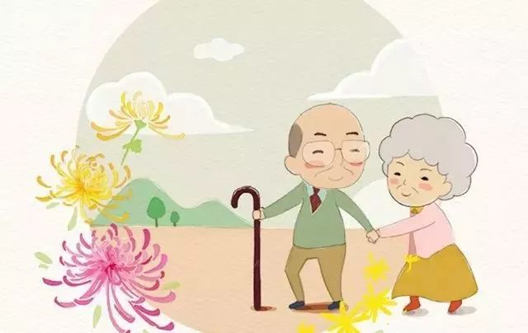
赏菊 Enjoying Chrysanthemum Flowers

Slide 10
赏菊 Enjoying Chrysanthemum Flowers
Chrysanthemum originated in China and was recorded in some Chinese books as early as the 5th century B.C. Chrysanthemum blossom in the ninth lunar month have a beautiful name of “flower of longevity”.

Slide 11
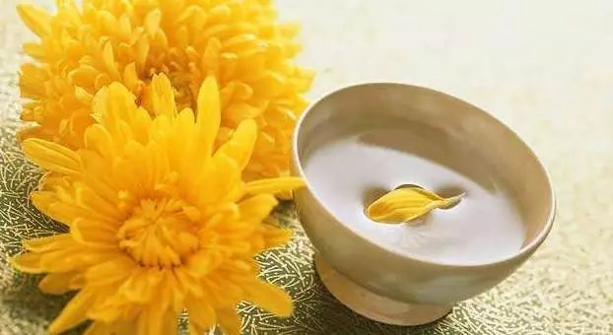
饮菊花酒 Drinking Chrysanthemum Flower Wine

Slide 12
饮菊花酒 Drinking Chrysanthemum Flower Wine
The chrysanthemum flower wine is unique in brewing. In ancient times，people usually picked fresh chrysanthemum flowers and leaves on the 9th of the 9th lunar month, and brewed the mixture of them and grains into the wine, which would not be drunk until the same day next year. The wine is said to have wholesome effects on sharpness of the eye, alleviation of headache, drop of hypertension, reduction of weight and removal of stomach trouble, thus contributing to longevity. It is said that the drinkers of the chrysanthemum wine would be free from evil and have strong physique against cold weather.

Slide 13
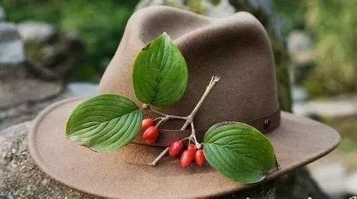
Wearing Dogwood 插茱萸

Slide 14
Wearing Dogwood 插茱萸
The dogwood is a species of evergreen arbor; it is heavy-scented plant whose fruit is edible and stock and leaves can be medicinal materials. They can expel insects, get rid of the humidity, help digestion and cure inner heat. It puts out purple flowers in spring and bears, in autumn, purplish-brown fruit that is sour, puckery and mild in nature.

Slide 15
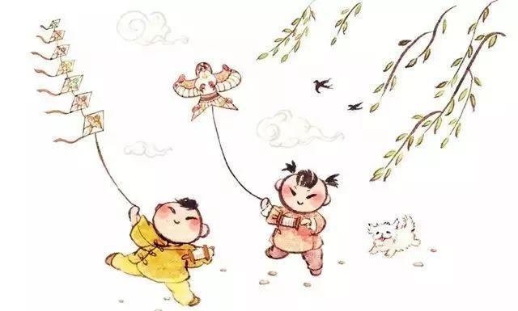
Flying a paper crane（放纸鸢）

Slide 16
Flying a paper crane（放纸鸢）
Paper crane is just kite. According to our traditions and customs, flying kites usually happen at the Qing Ming Festival. But Tomb Sweeping Festival is during the rainy season which obviously is not suit for flying a kite, while Double Ninth Day owns clear autumn sky and crisp air making kite flying a best outdoor activity.

Slide 17
Phrase Bank
Double Ninth Festival 重阳节
Festival for the Elderly 老年节
lunar calendar 农历
folklore 民俗
homonym 同音词
longevity 长寿
Tengwang Pavilion 滕王阁
Square dancing 广场舞
Chrysanthemum wine 菊花酒
brown sugar 红糖
Sunset Glow Tour Group 夕阳红旅游团
trendy word 流行词

Slide 18
高考真题：重阳节
［2015·新课标全国Ⅱ，25分］
假定你是李华，计划和同学去敬老院（nursing home）陪老人们过重阳节（the Double Ninth Festival）。请给外教露西写封邮件，邀她一同前往，内容包括：
1.出发及返回时间；
2.活动：包饺子、表演节目等。
注意：
1.词数100左右；
2.可以适当增加细节，以使行文连贯；
3.结语已为你写好。

Slide 19
优秀范文
Dear Lucy,
I’d like to invite you to join us for a visit to the nearby nursing home next Saturday for the Double Ninth Festival. It is the day for the elderly in our culture. We’ll go and make dumplings and cakes with the elderly people there. We’ll also spend some fun time together singing, dancing and playing games, which we hope will make them happy. We should be back around 4 o’clock in the afternoon. If you are able to come with us, please let us know and we’ll wait for you at the school gate at 9 in the morning.
Looking forward to your reply.
Yours,
Li Hua

Slide 20
高考真题：重阳节
假设你是某中学学生会主席李华，你校与本地一所国际学校经常举办联谊活动。你计划在重阳节组织学生到养老院去慰问老人，拟邀请国际学校的学生参加。请你根据以下内容要点给国际学校的学生会主席Tony写一封信。
要点：
向老人赠送礼物 (鲜花、自制贺卡……)；
为老人提供服务 (做清洁、陪老人聊天……)；
为老人表演节目 (唱歌、跳舞……)。
注意：
1. 词数为100左右；
2. 信的开头和结尾已为你写好 (不计入你所写词数)；
3. 已给出的信的开头和结尾不得抄入答题卡。

Slide 21
优秀范文
Dear Tony,
Chongyang, the traditional Chinese festival for the elderly, is coming around. We are planning to visit Nursing Home to celebrate the special day, and we would like to invite students from your school to join us.
We have planned several activities. When we get there, we will visit the elderly in their rooms in groups, presenting them with flowers and self-made cards to show our respect and love. Then we will do some cleaning and washing for them with the help of the nurses.
As some old people feel lonely, we may chat with them about their old days, changes of our city, or anything they are interested in. We may also give them some performances: singing, dancing, and so on.
I am sure we will both gain a better understanding of the elderly in China. If you have any suggestions, please let us know.
Looking forward to your early reply.
Yours,
Li Hua

Slide 22
THANK YOU

